Slide 1
SAFFRON INTERACTIVE DESIGN ASSIGNMENT
Amazon Logistics Learning Experience Redesign
OBJECTIVE:
Modernize the learning UI, improve responsiveness, and create a more engaging Amazon-inspired experience.
Prepared by: Niharika Sarkar

Slide 2


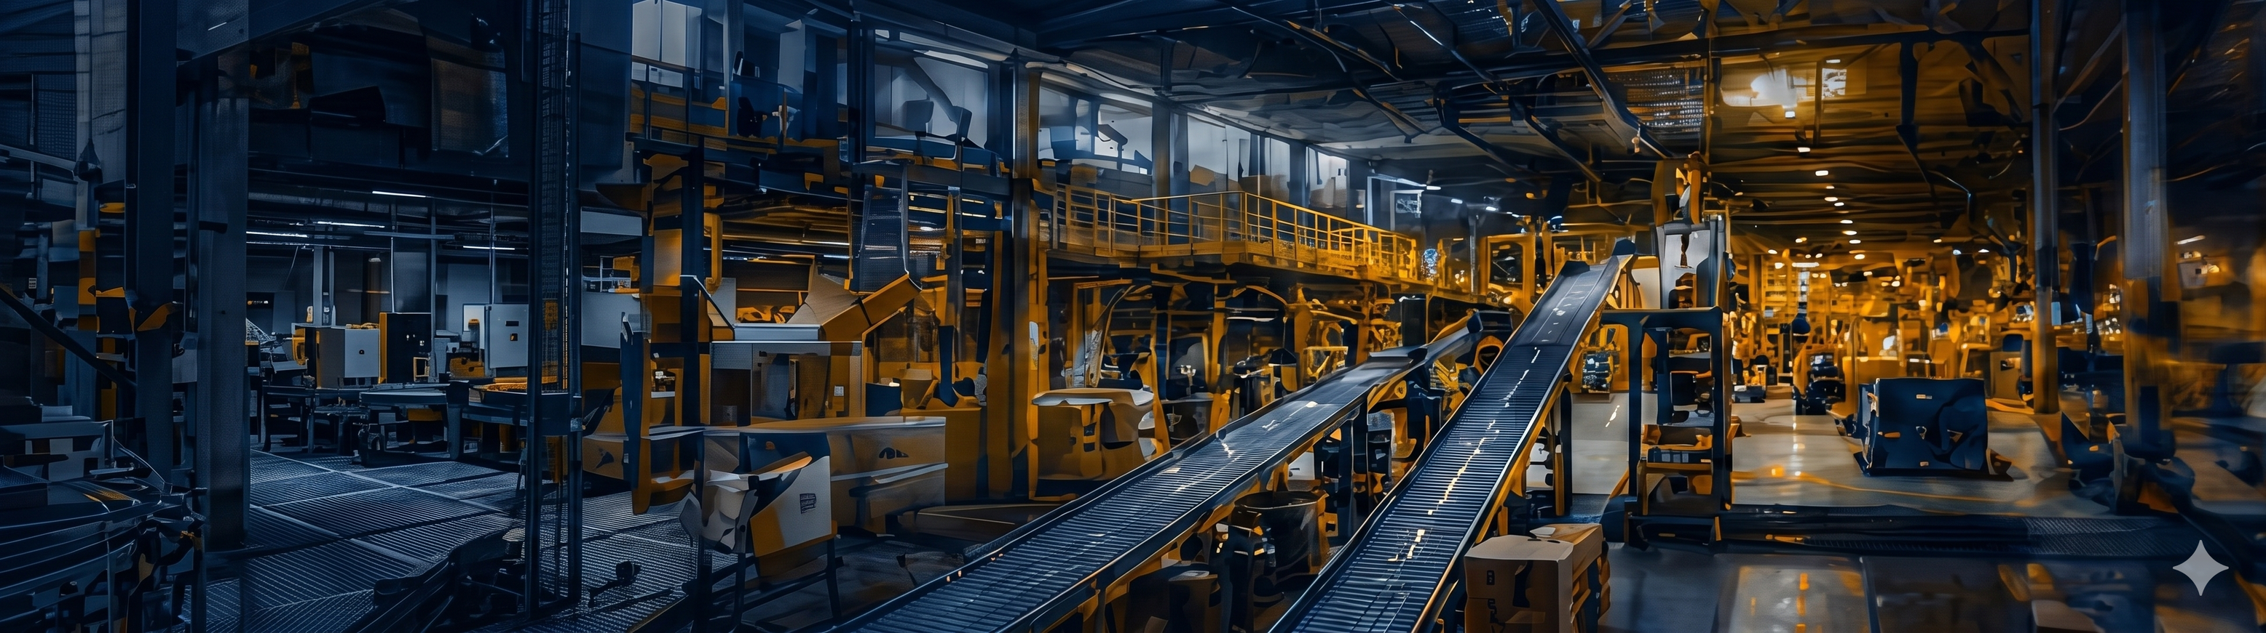

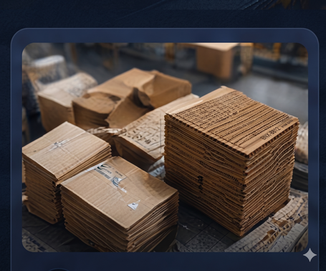

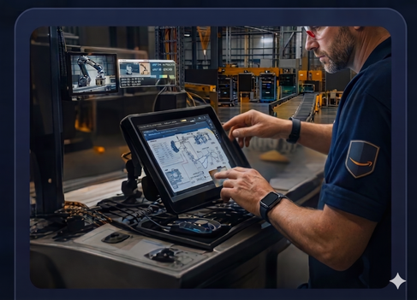

My Progress
Welcome to
Amazon Logistics Training
Understand the Box Recommendation System and keep our operations running smoothly.
PROBLEMS IDENTIFIED
Overall Progress
70%
• Outdated and dull visual branding
• Illustration-heavy screens lack realism
• Poor mobile adaptability of the course map
• Weak hierarchy and limited interactivity
1
2
3
4
A Special Day
Packaging Types
Box Recommendation
Using the tools
See how a typical day runs in our fulfilment centre.
Explore the different types of packaging we use.
Learn how our automated
system recommends the
right box.
Get familiar with the tools that power the system.
5 min
Completed
8 min
Completed
12 min
In Progress
10 min
Not Started
Managers play a key role in keeping our operations efficient.
This training will help you understand the reccomendation criteria so you can resolve issues quickly.

Slide 3
Overall Progress
Overall Progress
REDESIGNED COURSE MAP
70%
70%
Vertical modular learning journey optimized for Desktop and Mobile
1
A Special Day
1
A Special Day
5 min
5 min
• Amazon branding integration
2
Packaging Types
2
Packaging Types
• Mobile-first vertical layout
8 min
8 min
• Progress tracking
3
Box Recommendation
3
Box Recommendation
12 min
12 min
• Large touch-friendly cards
4
Using the tools
4
Using the tools
• Improved readability
10 min
10 min
Managers play a key role in keeping our operations efficient.
This training will help you understand the reccomendation criteria so you can resolve issues quickly.
Managers play a key role in keeping our operations efficient.
This training will help you understand the reccomendation criteria so you can resolve issues quickly.

Slide 4
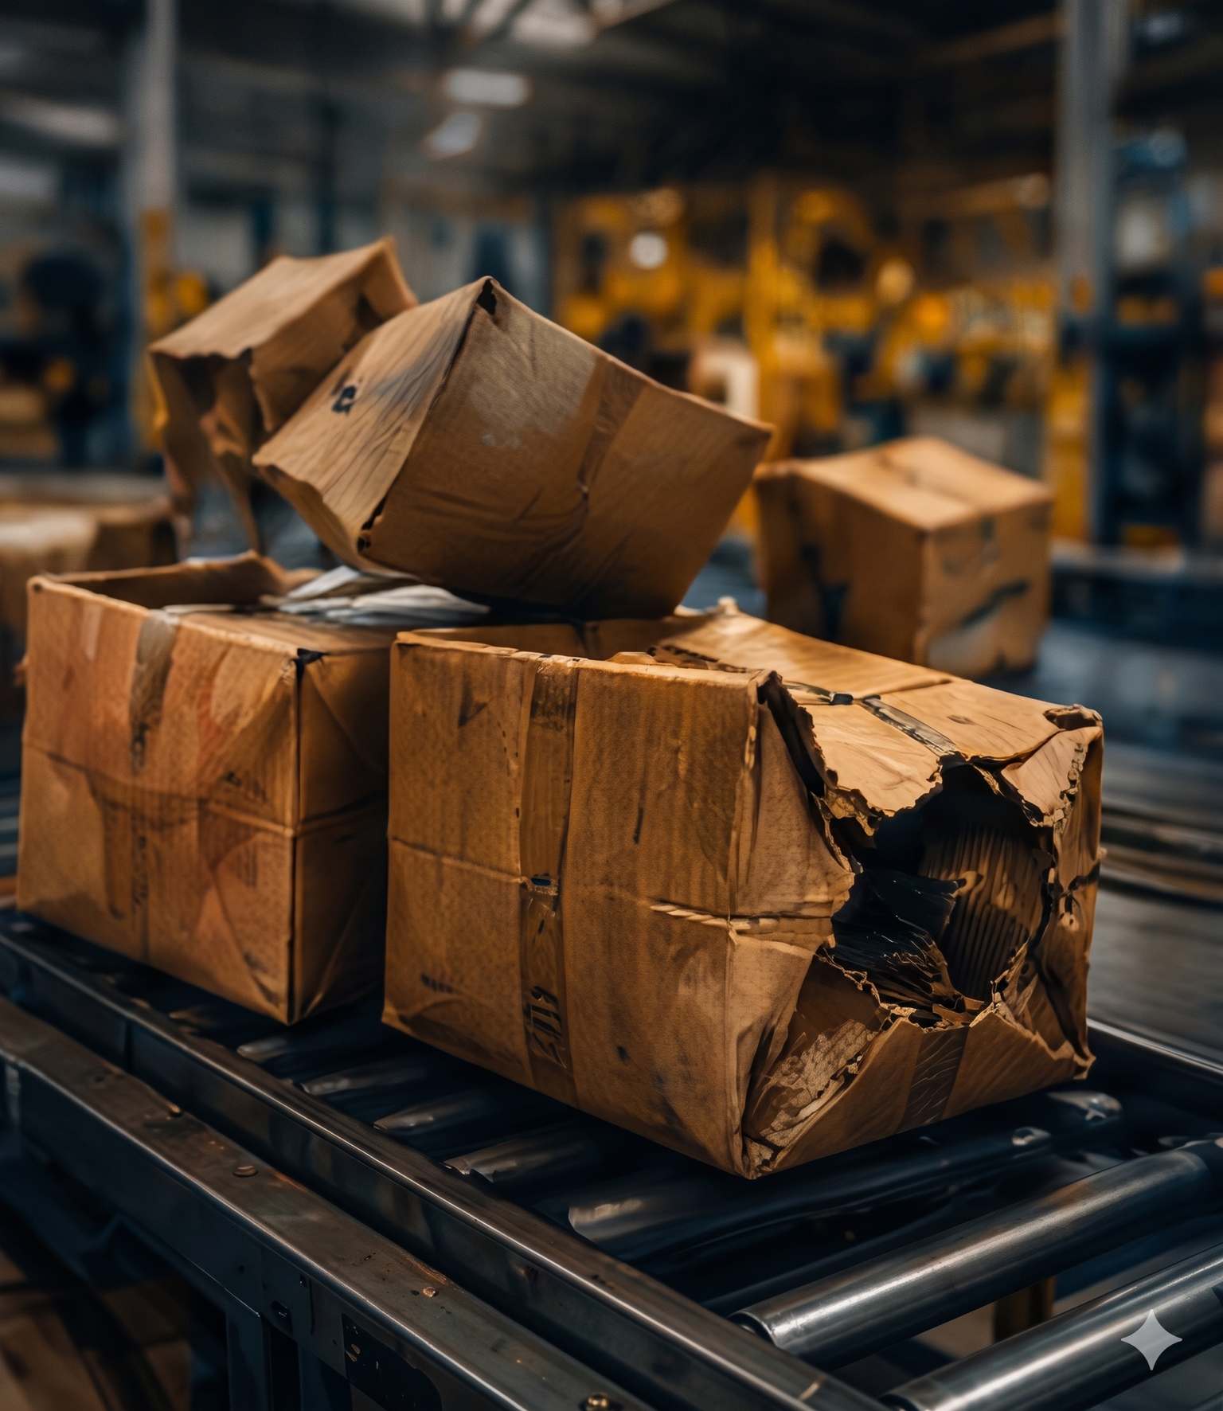


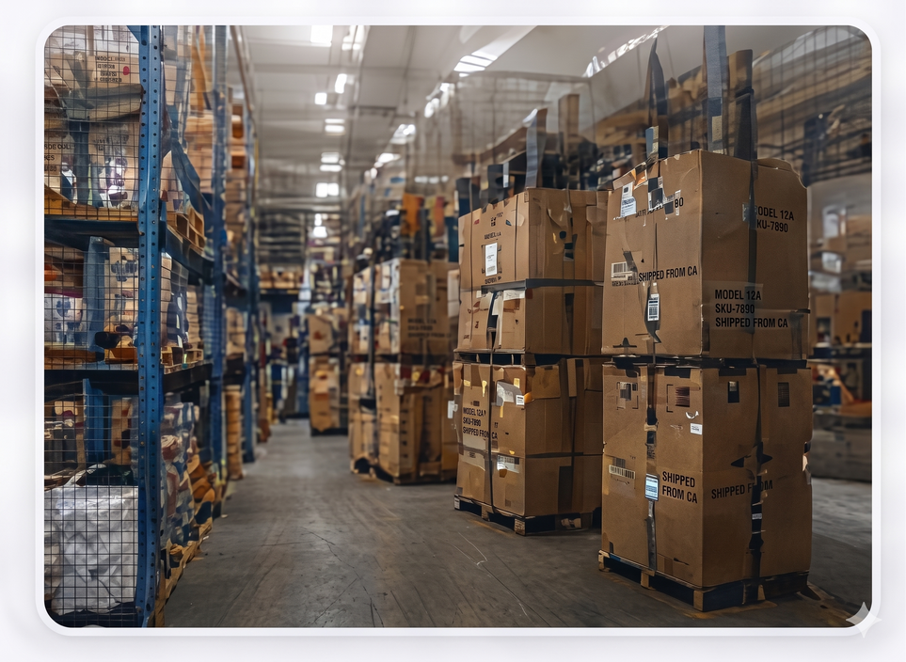
THE FALLOUT
All Statistics tell a Story
and exceeding the box compliance tolerance has far-reaching real-world consequenses.
REDESIGNED CAROUSEL EXPERIENCE
Let’s see what happened.
The Fallout : Interactive storytelling with immersive visuals and animated statistics.
Continue
Swipe navigation
< 01
05 >
Progress indicators
Real-world imagery
Customer Experience
Concessions
Costs
Motion transitions
Our aim is to put a smile on our customer’s faces. Instead, a high number of grotesque shipments left them scratching their heads.
The customer support team has been inundated with calls about damaged items with people demanding refunds.
Despite record sales figures, shipping costs spiralled out of control, and there is a backlog of items to reprocess.

Slide 5
MOBILE UX IMPROVEMENTS
• Responsive vertical learning flow
• Touch-friendly navigation
• Swipe-enabled interactions
• Sticky progress tracker
• Swipe-enabled interactions
Mobile-first approach
Engaging Content
vertical stacking,, large touch targets and simplified navigation for smaller screens.
Real imagery and storytelling create emotional connection and relevance.
Clear progress tracking
Consistent Navigation
Overakl progress bar and module status help learners know where they stand.
Sticky bottom navigation on mobile keeps key actions within easy reach.
Visual hierarchy
Accessible Design
Aa
Stronger typography, contrast and imagery guide learners to what matters most.
high contrasts, readable text icon support for better accessibility.
Design Rationale
The updated designs use vibrant Amazon-inspired branding, real imagery and a mobile-first approach to create an engaing, modern and accessible learning experience that drives understanding and action.

Slide 6

ANIMATION & INTERACTION SUGGESTIONS
• Hover and focus states
• Parallax imagery and onboarding motion
• Smooth screen transitions
• Microinteractions for buttons
Animated progress completion
Soomth transitions
Animated statistics
Home
My Progress
Resources
Profile
Fade and slide transitions between modules and carousel slides.
Numbers count up or highlight to draw attention to key metrics.
Parallax effects
Packaging types
Progress animations
8 min
Progress bar fills smoothly to give feedback and motivation
Subtle background movement adds depth and immersion.
Microinteractions
loading stats
Tap to open module
Progress Indicator
Buttons, cards and icons respond with subtle hover and tap states.
Skeleton loaders and progress indicators keep the experience smooth.
CONCLUSION
The redesign modernizes the Amazon Logistics learning experience by improving visual engagement, mobile usability, and interaction quality while maintaining enterprise-level clarity.
Design Rationale
Typography
4
Aa
Amazon Ember/ Inter
Clean, Modern and highly readable.
Submitted by :
Ms. Niharika Sarkar

